Slide 1

Bunnings Digital Platform

Slide 2
Engagement Overview
The leading retailer of home improvement and outdoor living products in Australia and New Zealand
Operating from a network of large warehouse stores, smaller format stores, trade centres and frame and truss sites, Bunnings caters for consumer and commercial customers.
Revenue across the 2019 financial year totalled $13.1 billion
Total of 377 trading locations made up of 267 warehouses, 75 smaller format stores and 32 trade centres, along with three frame and truss centres operating across Australia and New Zealand.

Slide 3
Objective
Redesign their ecommerce platform with aims to make DIY more easier for consumer
Transform from coupled architecture to headless architecture
Migrate from hosting partner to self managed Cloud Infrastructure
Highly Scalable, Secure and resilient solution
Automate everything with high level of DevOps maturity
Minimal Server administration

Slide 4
Challenges
Massive scale
22 page views per second in November 2019 to 230 page views per second in April 2020
10K product data ingestion every hour
Complexity and Learning Curve
Hybris CCV2
Sitecore
APIGEE
TeamCity
Coveo
Sitecore DAM

Slide 5
Solution Architecture

Slide 6
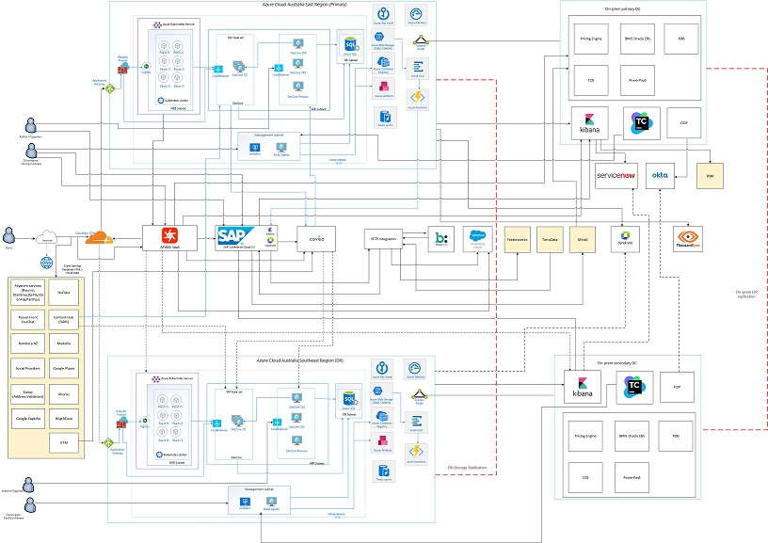
Solution Architecture

Slide 7
Solution Architecture
Azure Cloud platform with multi-region deployment
CDN – Cloudflare
Frontend – React JS hosted on AKS
Integration – APIGEE SaaS (plan to move it to hybrid version once Google releases it)
Content – Sitecore 9.3 XP hybrid solution using Sitecore on IaaS and DB on Azure SQL managed instance
Commerce – SAP Hybris CCV2
Search - Coveo
Other components – Azure Event Grid, Azure Functions, Azure Artifacts, Azure Key Vault,
Logging - ELK
Monitoring – Dynatrace
Support – pagerduty, Service Now

Slide 8
Infrastructure Automation

Slide 9




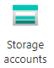
React Infrastructure Provisioning
Infrastructure Provisioning
main.tf
Azure Kubernetes Services
terraform.tfvars
backend.tfvars
Ingress Node
terraform.tfstate

Slide 10


Sitecore Scaled Infrastructure Provisioning
Infrastructure Provisioning
main.tf
Sitecore CM Virtual Machine
terraform.tfvars
Sitecore CM NIC / NSG
backend.tfvars
terraform.tfstate
Sitecore CM Virtual Machine
Playbooks
Dynamic Inventory
Sitecore CD Scaleset
Installation & Configuration
Ansible
Sitecore CD Loadbalancer
deploy_sitecore_managed_db.ps1
Azure SQL Managed Instance
DB Creation & Configuration

Slide 11
DevOps Pipelines

Slide 12














React
Collaboration
Security Static Code Scan(Sapient SAST)
Agile Team
Code Commit
Automated Builds
Automated Unit Tests
Code Quality
Dockerfile Lint
Build and Tag Docker Image
Automated Deployment to Dev
Image Security Scan
Publish Docker Image
Automated Deploy to Dev
Site speed Test
Post Deploy Sanity Test
Dynamic App Security Scan
Notification
Promote to QA
Automated Tests
Performance Test
Promote up to Production
Post Deploy Smoke Test
Production Operations
One Click Automated Deployment QA and above environment

Slide 13



Hybris
Security Static Code Scan(Sapient SAST)
Collaboration
SAP CCV2
Agile Team
Code Commit
Automated Builds
Automated Unit Tests
Code Quality
Automated Build
Promote to Dev
Post Deploy Sanity Test
Promote to QA
Automated Tests
Performance Test
Promote up to Production
Post Deploy Smoke Test
Production Operations

Slide 14

APIGEE SaaS
Collaboration
Security Static Code Scan(Sapient SAST)
Agile Team
Code Commit
Automated Builds
Automated Deploy to Dev
Post Deploy Sanity Test
Notification
Automated Deployment to Dev
Promote to QA
Automated Tests
Performance Test
Promote up to Production
Post Deploy Smoke Test
Production Operations
One Click Automated Deployment QA and above environment

Slide 15


Pull-requests Sanity
Agile Team
Code Commit (branch)
Automated Builds
Automated Unit Tests
Code Quality
Sonar status
Approve / Reject
Approval

Slide 16
SRE Practices

Slide 17
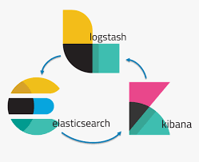




Centralized ELK
Azure Resources
Watcher Alerts
Logs Shipping
Apigee SaaS

Slide 18
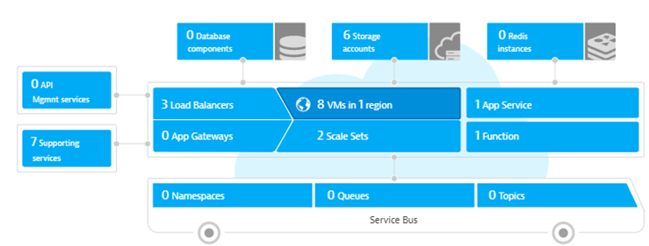
Dynatrace APM Monitoring
Dynatrace

Slide 19
Impact
Highly Scalable and Secure infrastructure.
Self serve rewrites implementation with more than 33000 rewrites
One click infrastructure provisioning
One click deployment.
SRE practices
Serverless NodeJS frameworks
Zero down time deployment using Blue/Green Deployment approach

Slide 20

Any questions?

